Slide 1


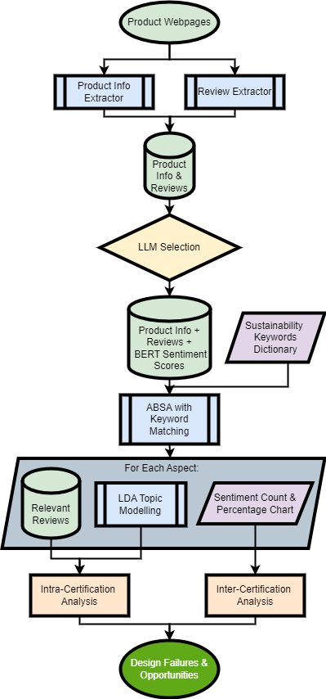
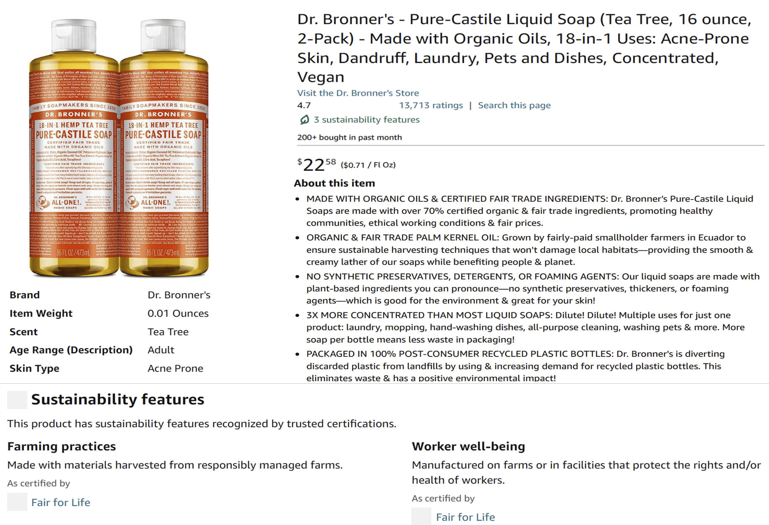
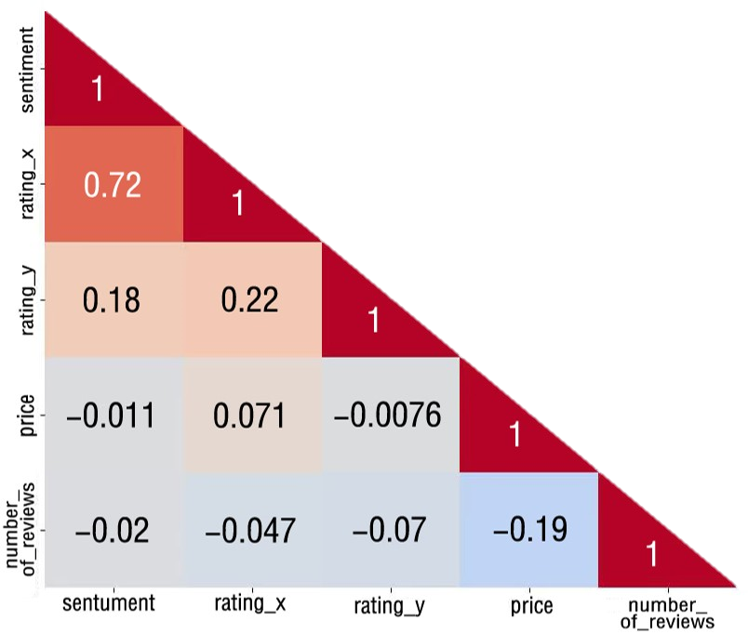
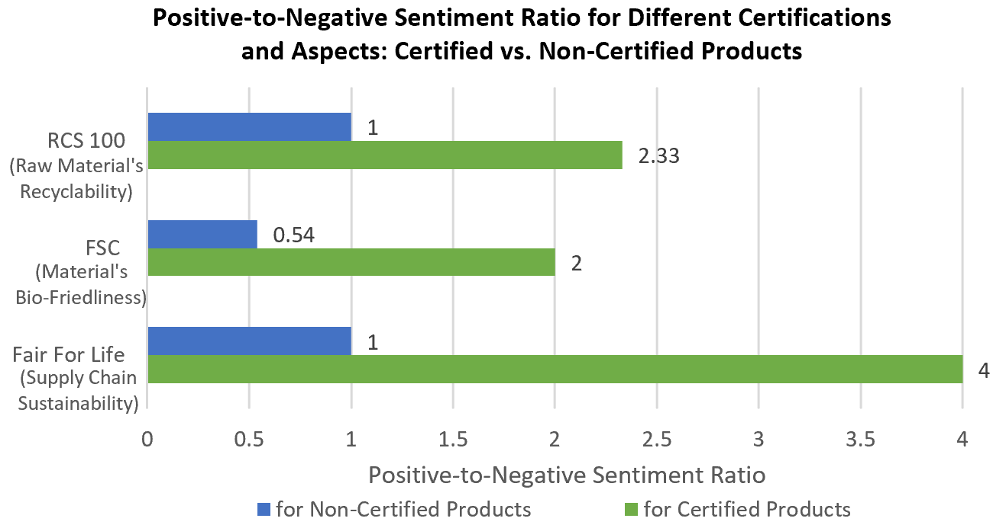
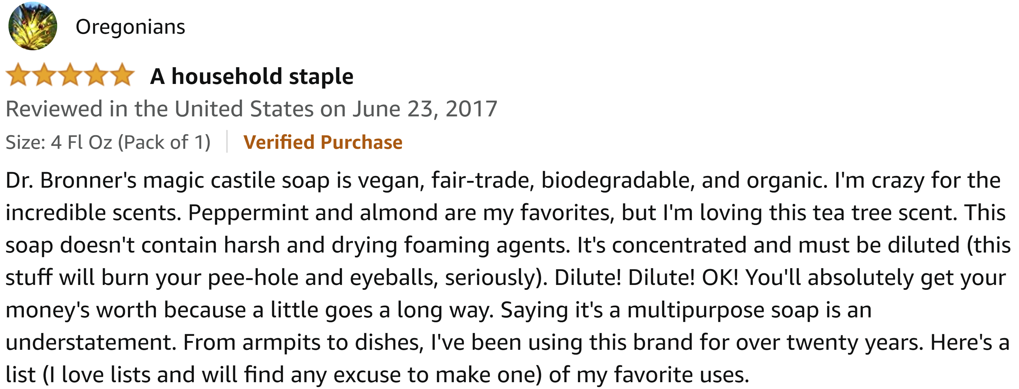
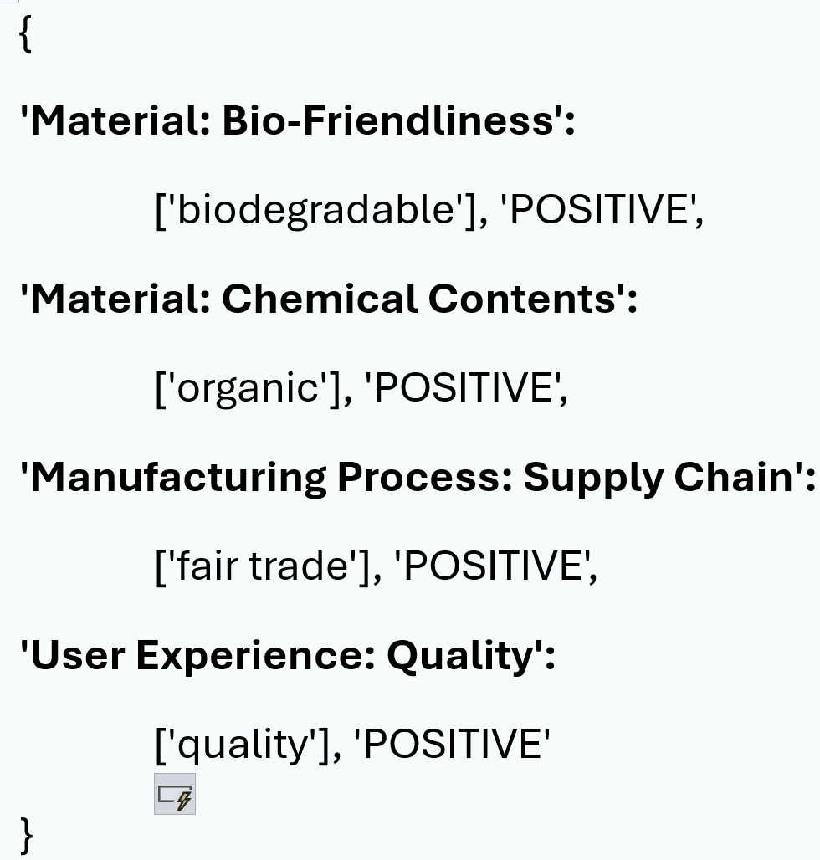
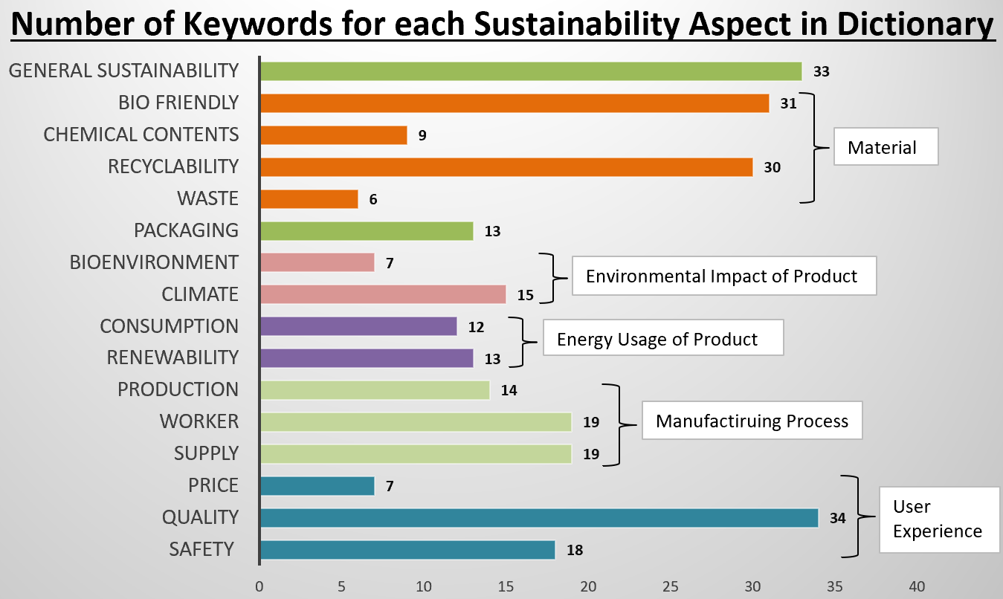
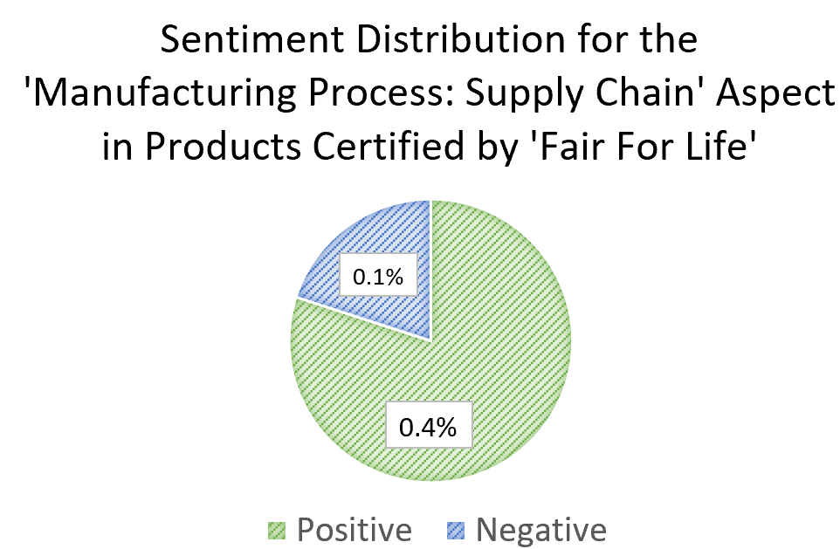
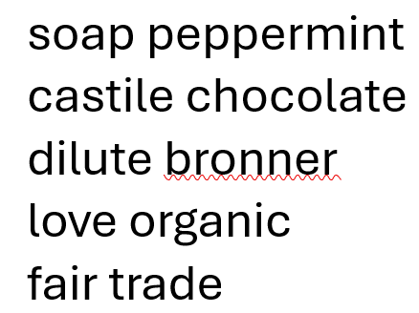

Identifying Sustainable Design Opportunities through
Integrated NLP Analysis of Certification Data and Customer Reviews
Zhe Wee Ng, Nicole Goridkov, Dr. Kosa Goucher-Lambert,
Berkeley Engineering Design Scholars Program
Abstract
Methods & Results
Sustainable Design Insights
In today’s market, sustainability is essential for product development and consumer choices. Companies face pressure to design sustainable products to meet regulatory standards and consumer demand. To navigate this landscape, sustainability certifications provide objective assessments, whereas customer reviews offer valuable insights into user perceptions.
Existing studies have demonstrated the potential of machine learning (ML) and natural language processing (NLP) techniques in extracting sustainable design insights from online reviews. However, these studies often lack practical implementation details, rely on limited datasets, or don’t integrate sustainability certification data.
To address these limitations, this research integrates sustainability certification information with customer reviews. We leverage a diverse range of datasets by scraping Amazon for products with various sustainability certifications and corresponding reviews. By employing advanced NLP techniques, we analyze reviews to identify sentiments and extract insights into sustainable design opportunities and failures, ultimately guiding more sustainable product designs.
S
S
S
S
S
S
Product designers should obtain and advertise specialized certifications, as customers show more positive sentiment towards the specific aspects they highlight compared to general certifications:
RCS 100 certified recyclable fabric items, often suffer from poor quality and durability, prompting consumers to demand thicker, higher-quality fabrics that offer a comfortable fit and reduce static cling.
FSC certified bamboo products like wipes, makeup removers, toilet paper, and pads are often ineffective, requiring excessive use and having poor moisture absorption, which leads to waste.
FFL certified organic products, praised for their peppermint ingredients in chocolate and body care items, have a limited range and availability.
BA certified printers often face toner and cartridge reliability issues, short lifespans, frequent replacements, and inadequate recycling processes, leading to waste.
BIFMA certified furniture faces challenges with unclear assembly instructions, missing parts, and complex steps, resulting in issues like the inability to tilt monitors.
BERT Sentiment and Rating Correlation Matrix
ABSA Results
Future Directions
Incorporate product information into the NLP process.
Refine the data collection process to reduce bias.
References
LDA Modelled Topic
Saidani, Michael et al. "Combining life cycle assessment and online customer reviews to design more sustainable products – Case study on a printing machine." 2022.
Saidani, Michael, Harrison Kim, and Bernard Yannou. "Can Machine Learning Tools Support the Identification of Sustainable Design Leads From Product Reviews? Opportunities and Challenges." 2021.
Lin, Tong, Tianliang Xu, Amit Zac, and Sabina Tomkins. "SUSTAINABLESIGNALS: An AI Approach for Inferring Consumer Product Sustainability." No date provided.
Analysis indicates a positive correlation between products with a “Fair for Life” certification and customer perceptions of a fair and sustainable supply chain. Therefore, product designers aiming to appeal to consumers who prioritize these values, or who wish to market their products accordingly, are advised to obtain the Fair for Life certification.
Referred Sustainability Certifications
For organic products (including but not limited to soap, castile and chocolate) certified by Fair For Life, product designers are encouraged to use peppermint ingredient for products
RCS 100: Recycled Claim Standard 100
FSC: Forest Stewardship Council
FFL: Fair For Life
BA: Blue Angel
BIFMA: Business and Institutional Furniture Manufacturers

